Slide 1

ROUTINE HEALTH INFORMATION SYSTEMS
A Curriculum on Basic Concepts and Practice
MODULE 6:
RHIS Data Demand and Use
CASE STUDY:
Community Health Information System in Action in SNNPR/Ethiopia
The complete RHIS curriculum is available here:
https://www.measureevaluation.org/our-work/ routine-health-information-systems/rhis-curriculum

Slide 2
Use of RHIS Information at All Levels of the Health System
Patient/client level and community/management level: Focus on improving quality of care, including continuity of care, as well as on behavioral change
Facility management level: Focus on service delivery coverage and quality of care
District management level: Focus on management of health services and resources as well as on service delivery coverage and quality
Regional and national levels: Focus on health planning, program management, and policy development

Slide 3
This Case Study Is About Use of RHIS Information…
…. at community management level: focus on improving quality of care, including continuity of care, as well as on behavioral change
Ethiopia’s community health system is managed by health posts staffed by two female health extension workers (HEWs) covering around 5,000 people
Currently, around 20,000 health posts in Ethiopia
HEWs provide package of preventive, promotive, and basic curative services, as part of the country’s Health Extension Program (HEP)

Slide 4
Community Health Information System (CHIS) in Ethiopia
Established in 2008 as component of broader health facility-based health management information system (HMIS)
Based on data needs of HEP
Central piece = FAMILY FOLDER
  Kept at the health post (HP)
  Contains information on household (HH) members and characteristics such as water, sanitation, and hygiene (WASH) facilities and long-lasting insecticidal nets (LLINs) for malaria prevention
  Contains health cards and integrated maternal and child health (MCH) cards of HH members
Tickler file system for continuity of care for chronic diseases and the maternal, newborn, and child health (MNCH) continuum of care
Notes:
Refer participants to Module 6: Ethiopia Case Study 1 Handouts Package.

Slide 5
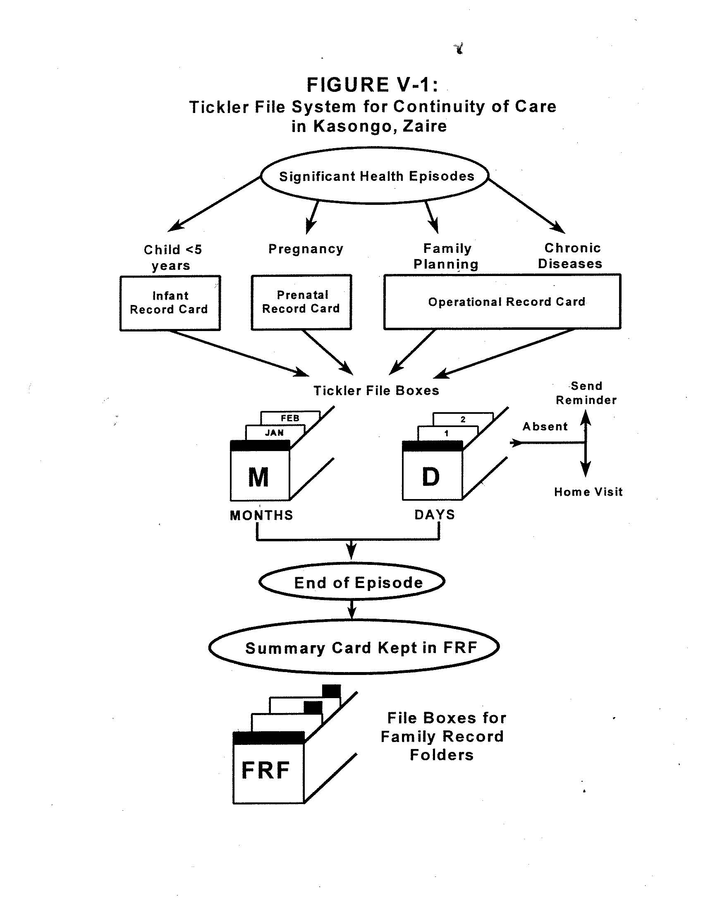

The Tickler File System
A system to organize health cards of clients who have significant health episodes and need follow-up services
Health cards arranged in monthly and daily boxes
In Ethiopia, at HPs, the HEWs only use monthly boxes for arranging health cards of pregnant women, <1 children, and FP clients according to the month of their next visit

Slide 6
Case Study 1: CHIS in Action
This case study is on how HEWs perceive the new CHIS in their HP in SNNPR (southern region in Ethiopia, with population of 20 million).
Handout for reading by course participants
Group work: Discuss impact of using CHIS data on community health in Ethiopia
Notes:
Refer participants to Handout 6.4: Ethiopia Case Study (“Community Health Information System in Action in SNNPR”)

Slide 7
Group Work: Discussion Points
Does the CHIS respond to community health data needs in Ethiopia?
List potential use of CHIS data to improve community health services delivery.
Describe how the family folder was implemented in the HP’s catchment area.
Describe how the tickler file system can help to ensure continuity of care for patients with chronic illnesses and for MNCH clients.

Slide 8
Group Presentations (3 Minutes per Group)
In plenary, groups report their views on each of the discussion points.
Groups report any problems they identified in the design of the CHIS in Ethiopia.
Briefly discuss the available documentation (family folders; individual record cards)

Slide 9
Case Study 2: Getting to Know Your Performance
This case study is on understanding the CHIS data from an HEW’s perspective.
Group work: Discuss what an HEW sees in the aggregate data and for what purposes she can use those data.
Notes:
Refer participants to the handout “Ethiopia Case Study 2: Analysis and Use of Data at the Community Level.” See also the trainer’s version of this handout for instructions on how to conduct the group work.

Slide 10
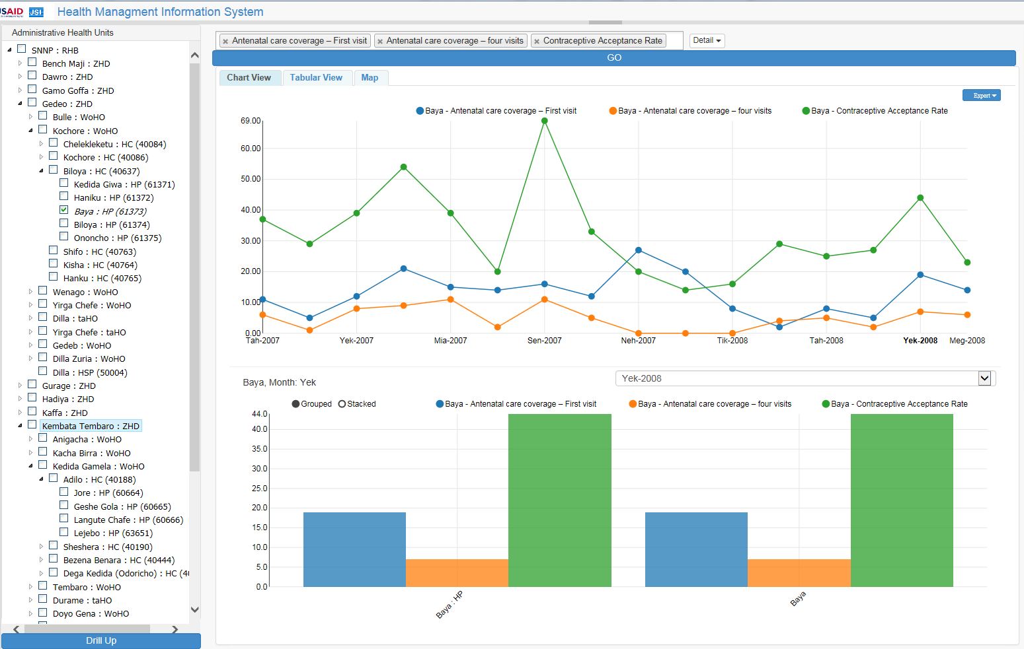
Case Study 2: Health Post Performance─ Chart
Notes:
Module 6, Session 4 Handout: Ethiopia Case Study 2 for Participants (“Analysis and Use of Data at the Community Level”)

Slide 11
Case Study 2: Health Post Performance─ Table
Ethiopia Month/Yr | ANC - First visit | ANC - Fourth visit | Contraceptive acceptance
Tah 2007 | 11 | 6 | 37
Tir 2007 | 5 | 1 | 29
Yek 2007 | 12 | 8 | 39
Meg 2007 | 21 | 9 | 54
Mia 2007 | 15 | 11 | 39
Gin 2007 | 14 | 2 | 20
Sen 2007 | 16 | 11 | 69
Ham 2007 | 12 | 5 | 33
Neh 2007 | 27 | 0 | 20
Mes 2008 | 20 | 0 | 14
Tik 2008 | 8 | 0 | 16
Hid 2008 | 2 | 4 | 29
Tah 2008 | 8 | 5 | 25
Tir 2008 | 5 | 2 | 27
Yek 2008 | 19 | 7 | 44
Meg 2008 | 14 | 6 | 23
Notes:
Module 6, Session 4 Handout: Ethiopia Case Study 2 for Participants (“Analysis and Use of Data at the Community Level”)

Slide 12
Group Work: Discussion Points
How is this health post performing in terms of maternal health care?
Why is the HEW also comparing the contraceptive acceptance rate with antenatal care data?
What actions can the HEW take using the data?

Slide 13
Group Presentations (3 Minutes per Group)
In plenary, groups report their views on each of the discussion points.
Briefly discuss the opportunities and constraints for the HEWs to decide on the actions they can take in response to a health post’s performance data.

Slide 14
ROUTINE HEALTH INFORMATION SYSTEMS
A Curriculum on Basic Concepts and Practice
This presentation was produced with the support of the United States Agency for International Development (USAID) under the terms of MEASURE Evaluation cooperative agreement AID-OAA-L-14-00004. MEASURE Evaluation is implemented by the Carolina Population Center, University of North Carolina at Chapel Hill in partnership with ICF International; John Snow, Inc.; Management Sciences for Health; Palladium; and Tulane University. The views expressed in this presentation do not necessarily reflect the views of USAID or the United States government.

